Slide 1


MINI PROJECT
Semester - V
Title: “Edu_hub”

Slide 2
Project Mentors: Mr. Anand Gupta Mrs. Ruchi Gupta r
Submitted by:
Akshat Kumar Sinha(181500063)
Aman Saxena(181500077)
Akarshit Srivastava(181500056)
Harshit Saxena(181500258)
Varun Saxena(181500783)

Slide 3
CONTENTS
Abstract
Reason for selecting this topic
Objective
Introduction
Hardware and Software used
Screenshots
Future Scope
Contribution the project would make
Conclusion

Slide 4
ABSTRACT
In today’s time, students want to learn new technologies and excel in their college academics for a better carrier and future. Now, if a student couldn’t attend his/her classes, they certainly search the internet for notes and concept clearance. Now, they literally waste their 25-30 minutes searching for a particular topic on Google, trying to find the perfect link. So, we claim that our website, ‘Edu_hub’ will certainly solve this problem by providing a platform to students where they can find notes of their subjects.
Specially for GLA University students, we will provide subject notes of all CSE subjects of First year to Final year. There will be YouTube links for various coding and educational videos, and some motivational quotes for students who sometimes feel low due to their academic pressures.
The scope of this Project is to provide a complete package of resources to students who are interested in CSE domain and want to nurture their skills from an early stage.

Slide 5
Reason for Selecting this Topic
Reason for choosing this topic is to provide a platform to students where they can find all the resources relating to their respective CS domain. We are building a Web browser-based application which will be responsive as well so that students can access our provided content on their smart phones too.

Slide 6
OBJECTIVE
The main objective of the Project is to provide a platform where Engineering students get all the information(notes) of the particular subject, instead of wandering on many different sites over Internet. This will reduce their time of searching and help them over their studies.
We have provided the pdf of all practice sheets which are provided by the teachers in their classes and ppts which are made by teachers(lecturers).
We believe that the Internet should not only be a place for Entertainment and social media, but also be used as a tool to enhance one’s skills and excel in their academics.

Slide 7
INTRODUCTION
So basically, Edu_hub is an Educational dynamic website which will help students to have all the study materials and related stuffs in one place to help them through their academic life. We are building a Web browser-based application which will be responsive as well so that students can access our provided content on their smart phones too.

Slide 8
Hardware and Software used
Hardware used :
Laptop with 8gb hard disk
1TB Ram
Strong internet connection
Processor core i5 8th Gen

Slide 9
Software used:
Frontend Technologies :
HTML :HTML stands for Hypertext Mark-up Language. It is the standard mark-up language for documents designed to be displayed in a web browser.
CSS : CSS stands for Cascading Style Sheets. CSS describes how HTML elements are to be be displayed on screen, paper, or in other media. CSS saves a lot of work; it can control the layout of multiple web pages all at once. External style sheets are stored in CSS files.
JavaScript: JavaScript is a web-based scripting language that has been widely used in web application development in particular, it is often used to add a variety of dynamic functions to web pages, providing users with a smoother and more pleasing browsing experience. In fact, all modern HTML pages use JavaScript.

Slide 10
Bootstrap : Bootstrap is a framework to help you design websites faster and easier. It includes HTML and CSS based design templates for typography, forms, buttons, tables, navigation, modals, image carousels, etc. It also gives you support for JavaScript plugins. Bootstrap’s responsive CSS adjusts to phones, tables and desktops.
Backend - Technologies :
PHP : PHP is a server-side scripting language that is used to develop Static websites or Dynamic websites or Web applications. PHP stands for Hypertext Pre-processor that earlier stood for Personal Home Pages.
MySQL: MySQL is a relational database management system based on SQL – Structured Query Language. The application is used for a wide range of purposes, including data warehousing, e-commerce, and logging applications. The most common use for MySQL however, is for the purpose of a web database

Slide 11
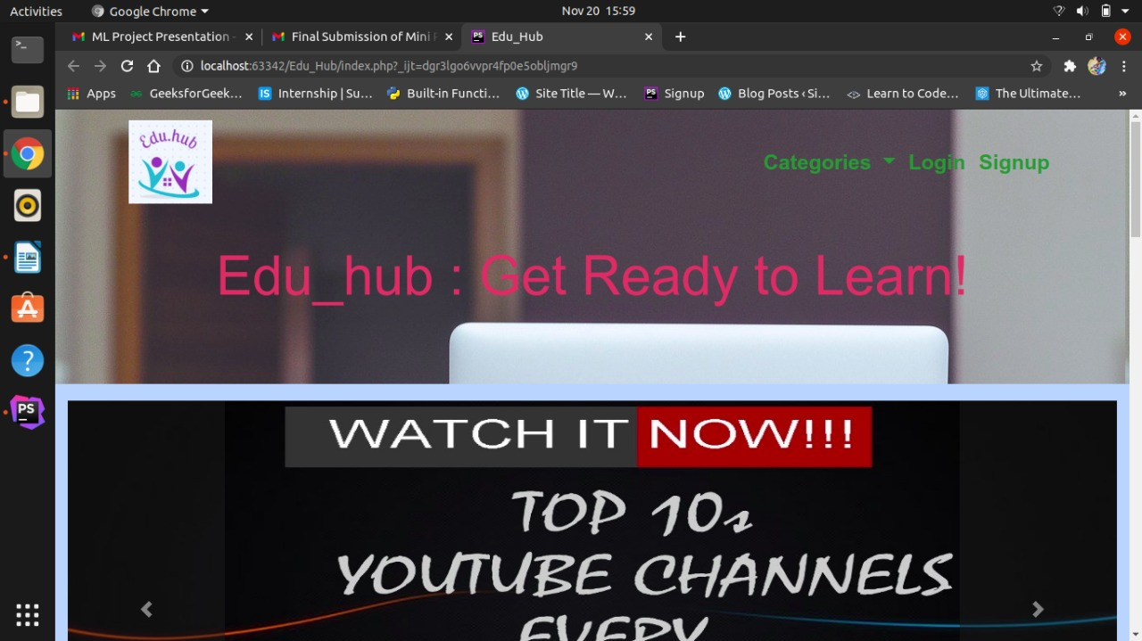
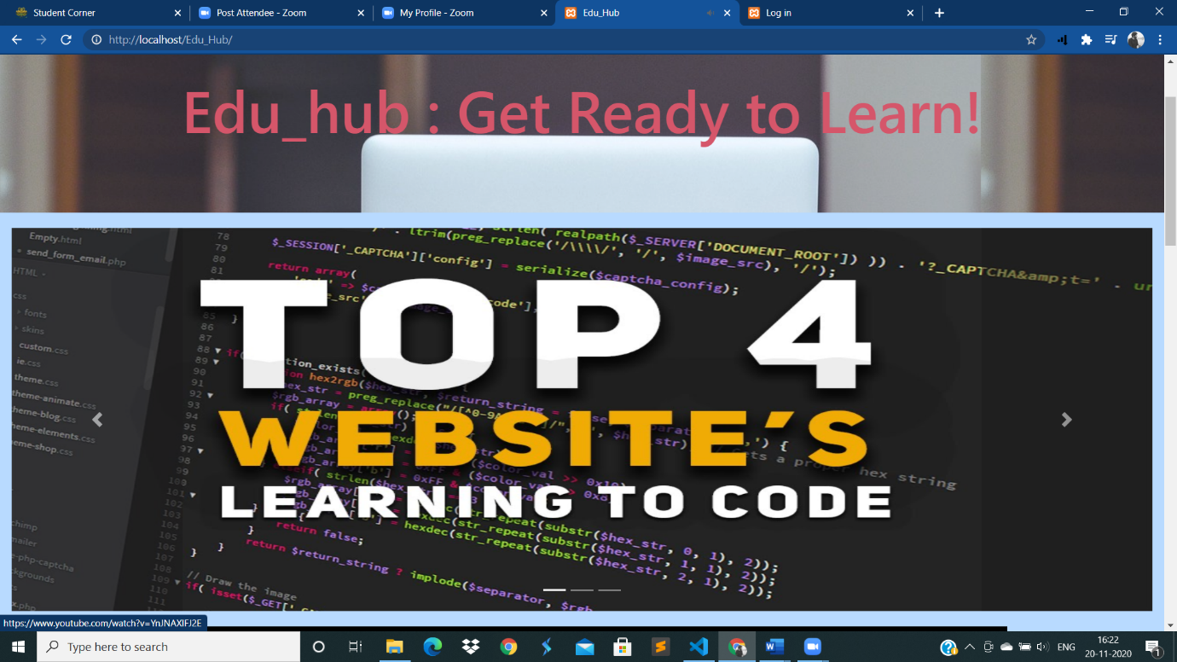
SCREENSHOTS
Homepage

Slide 12
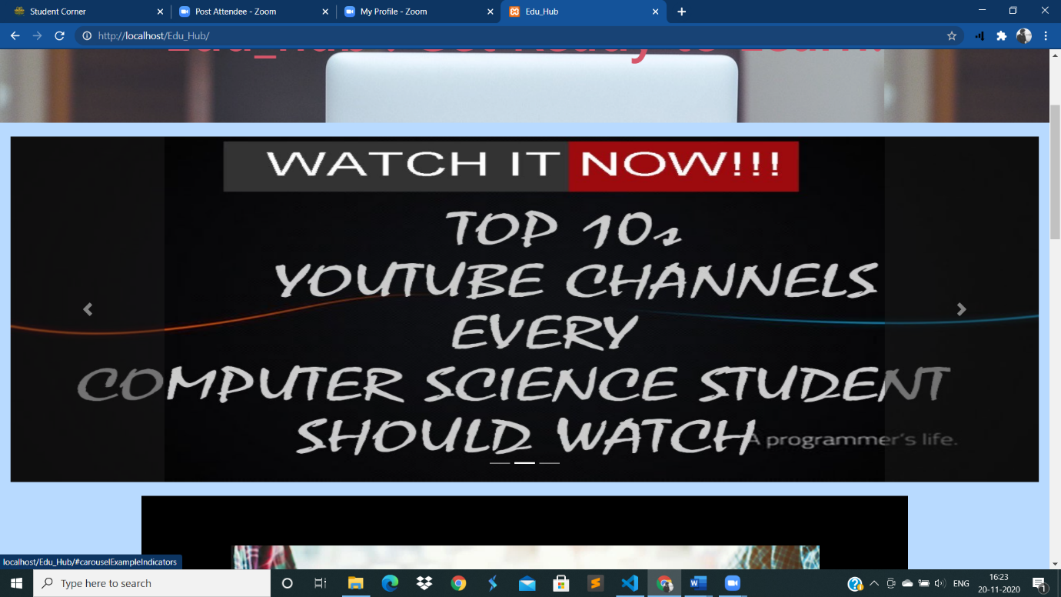
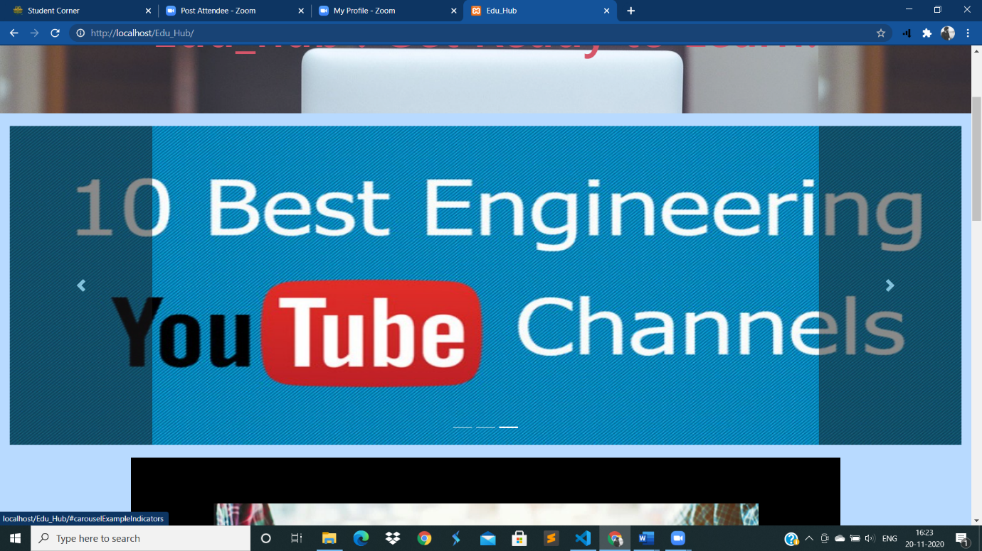

Slide 13
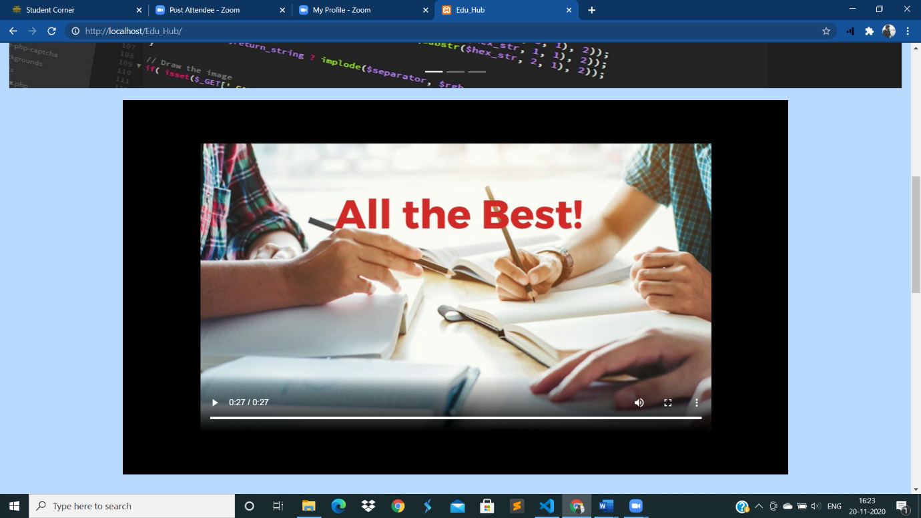
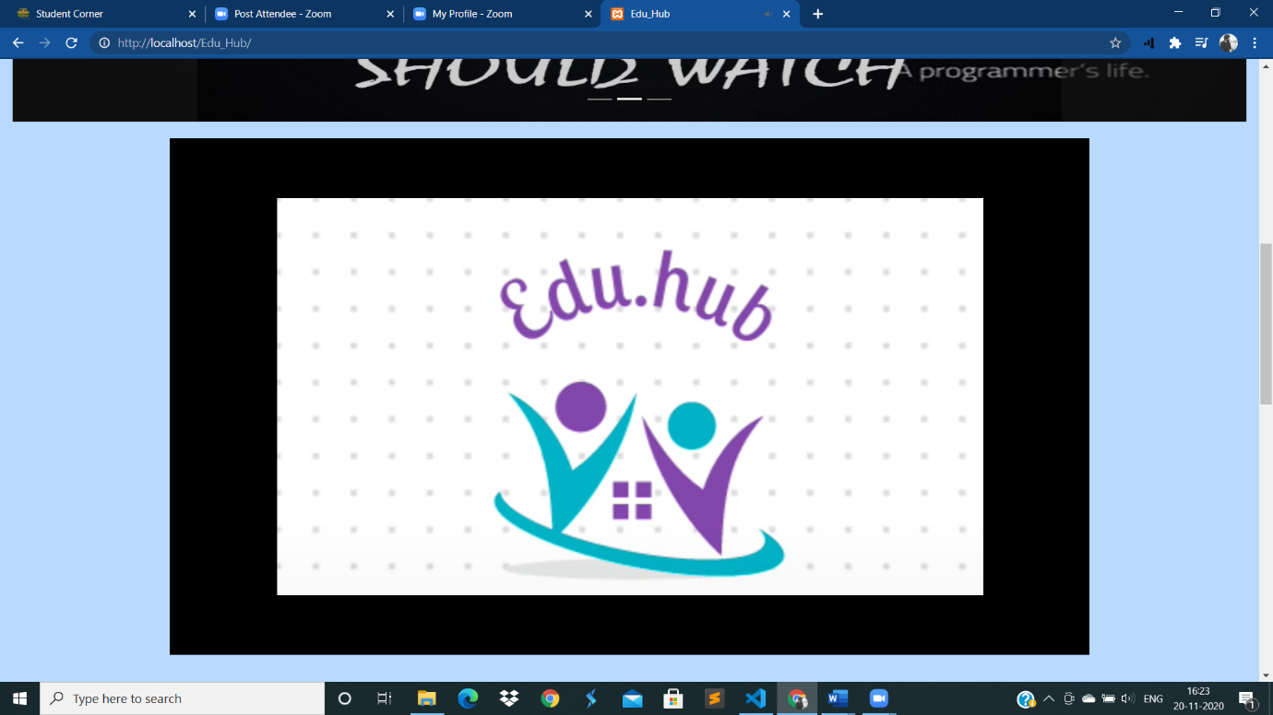

Slide 14
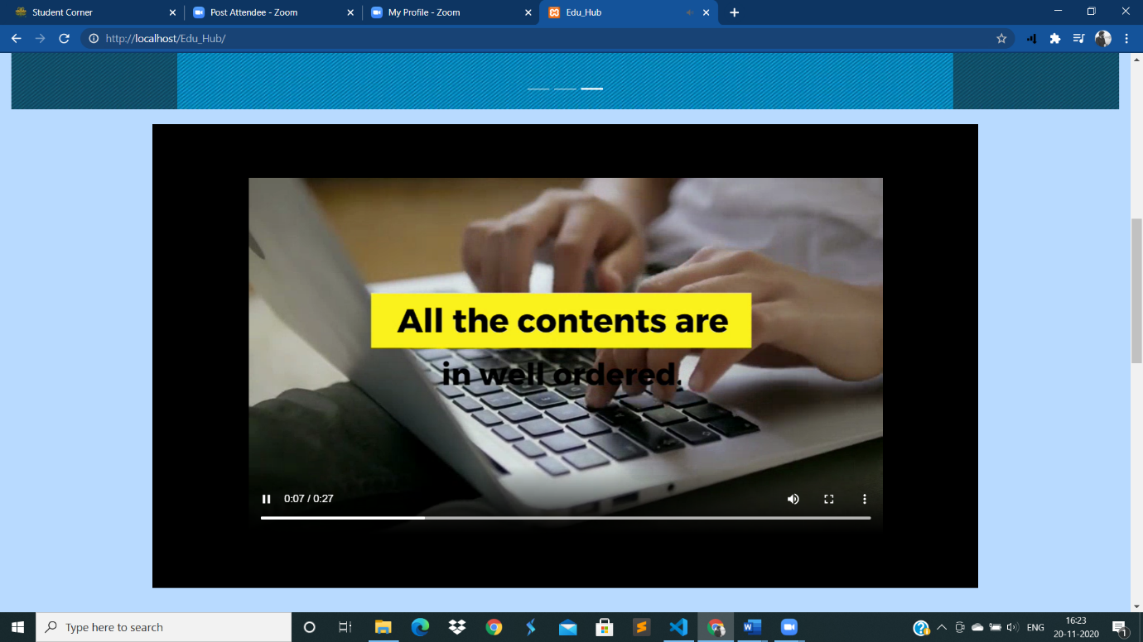
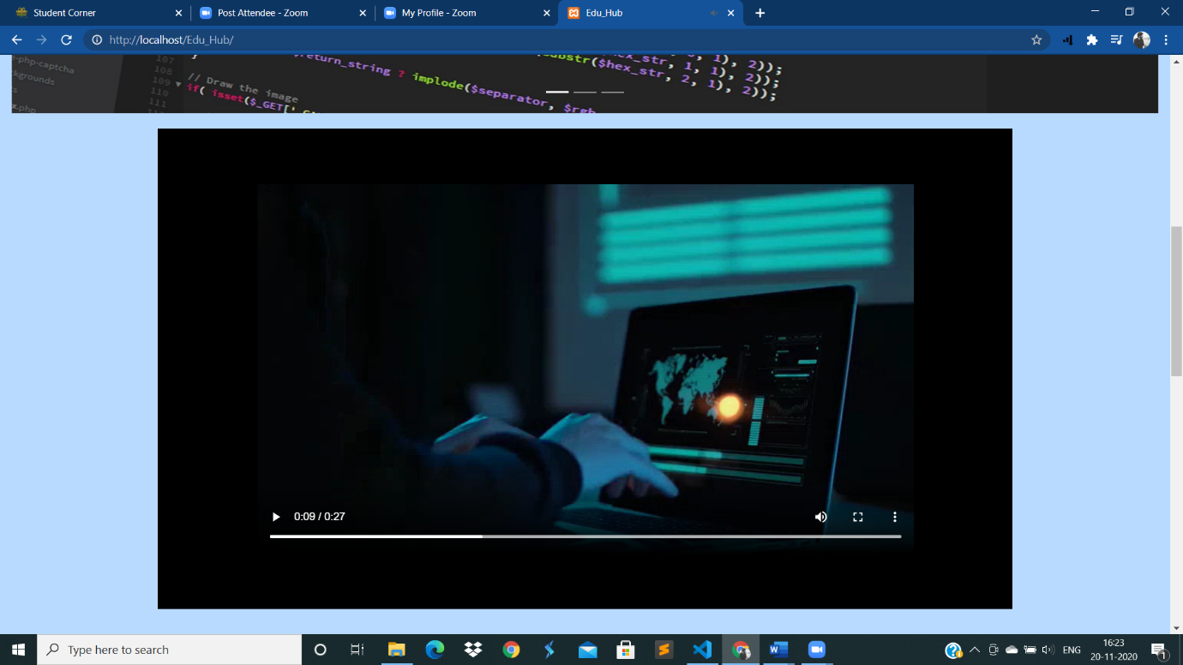

Slide 15
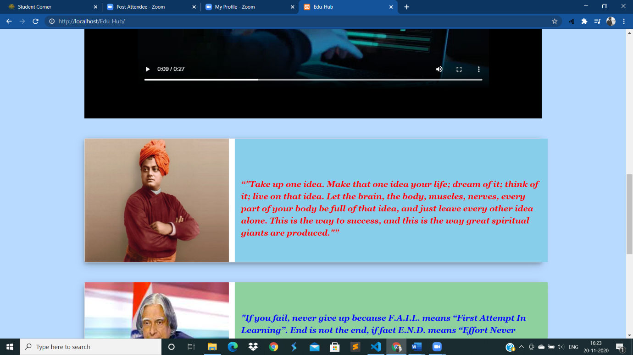
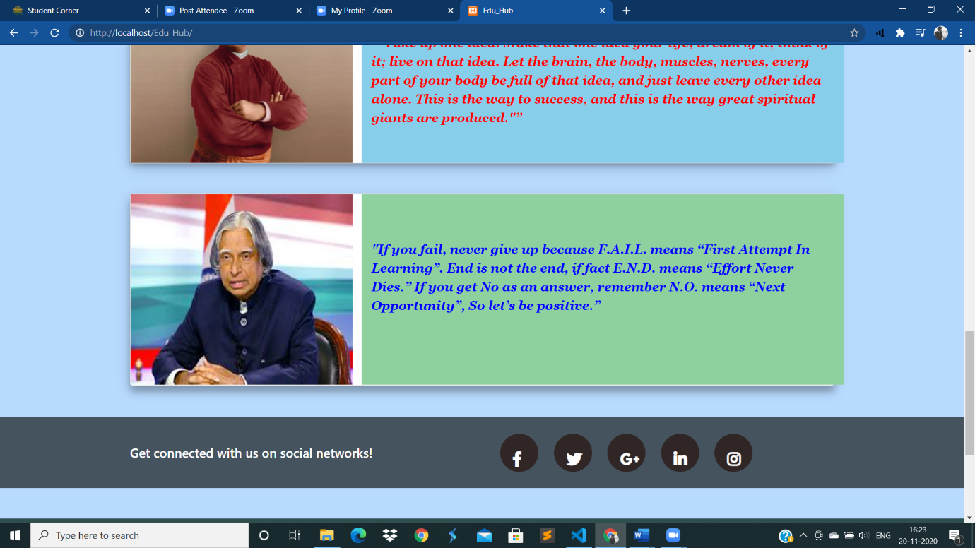

Slide 16
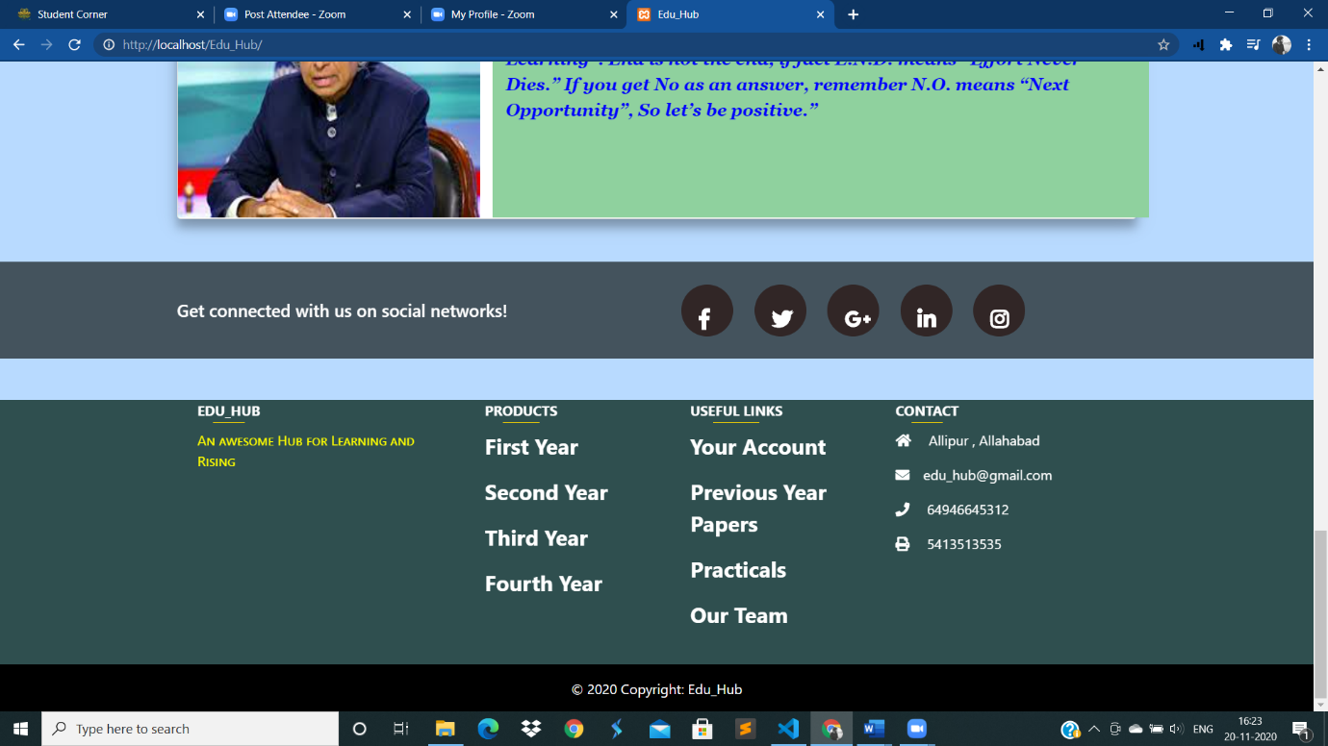

Slide 17
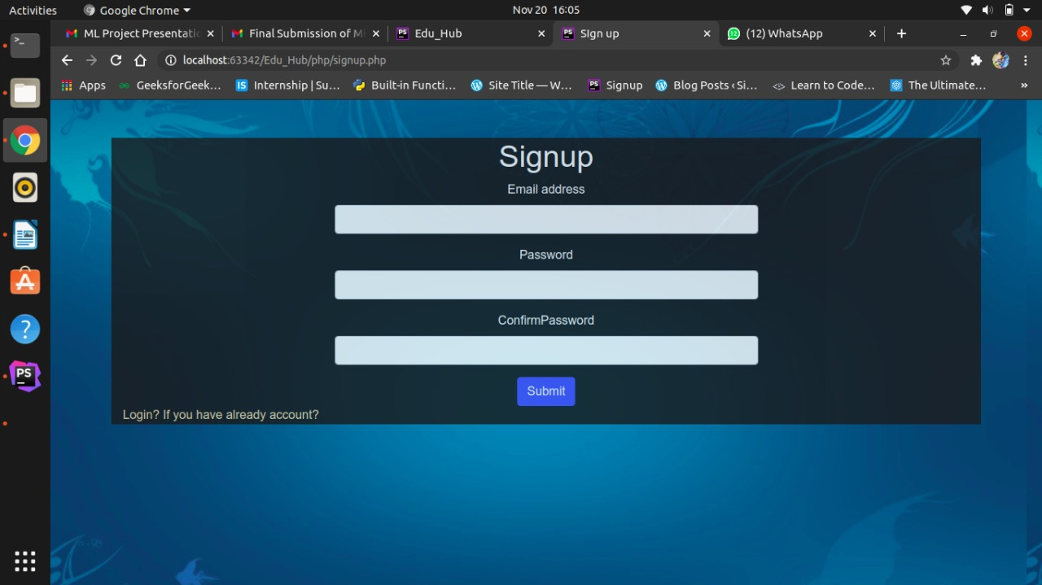
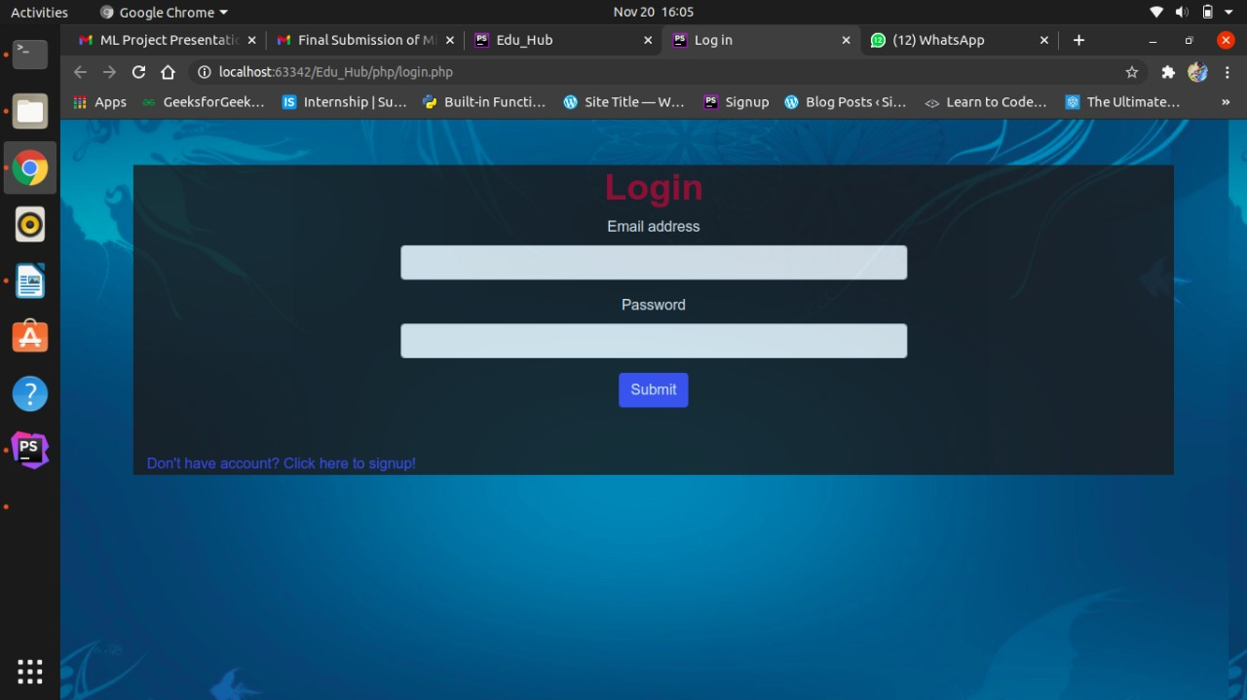
Login and signup pages

Slide 18
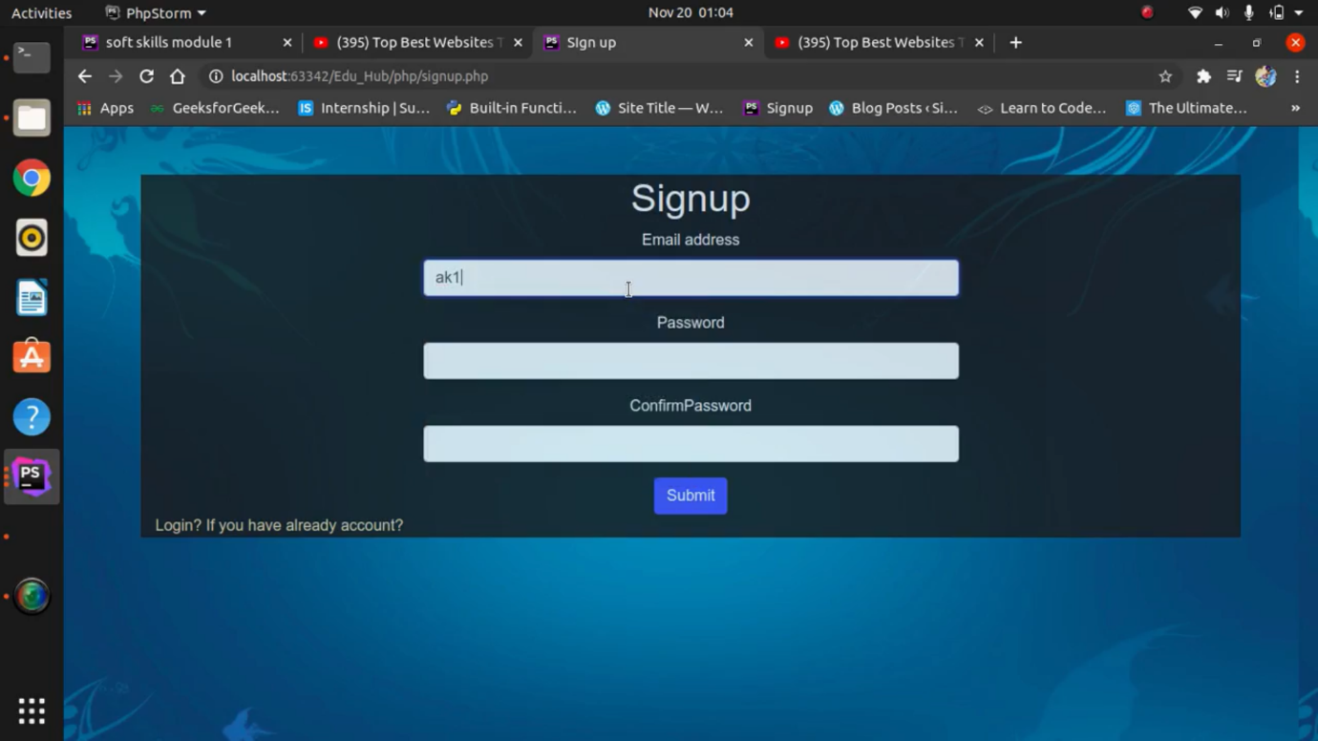
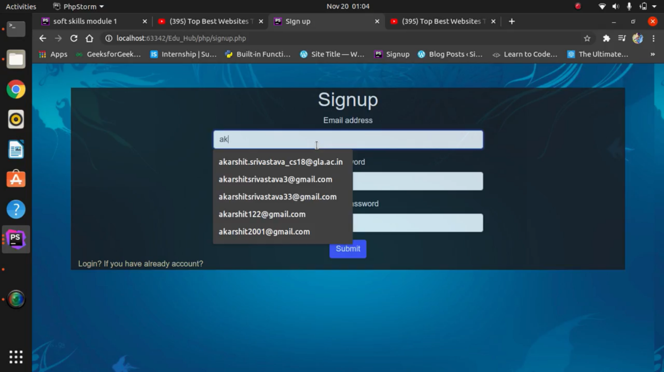

Slide 19
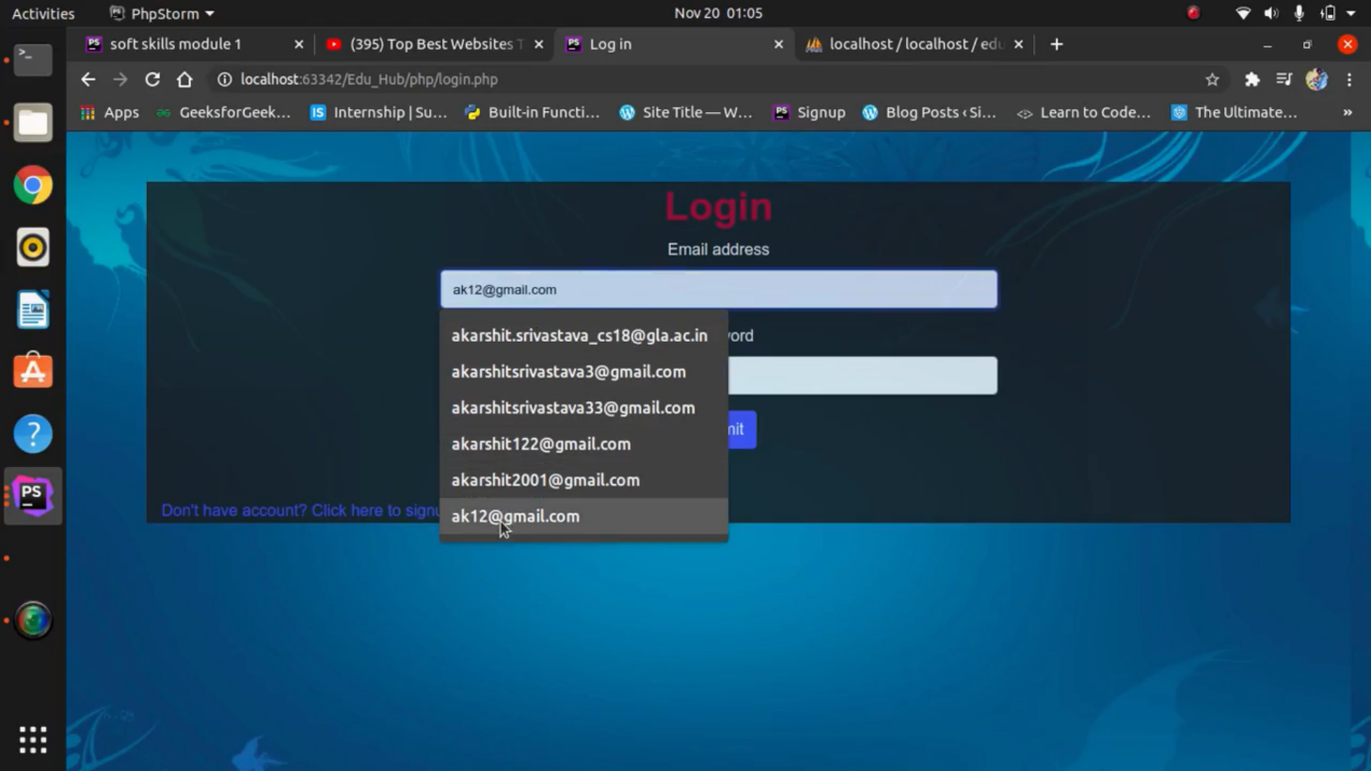
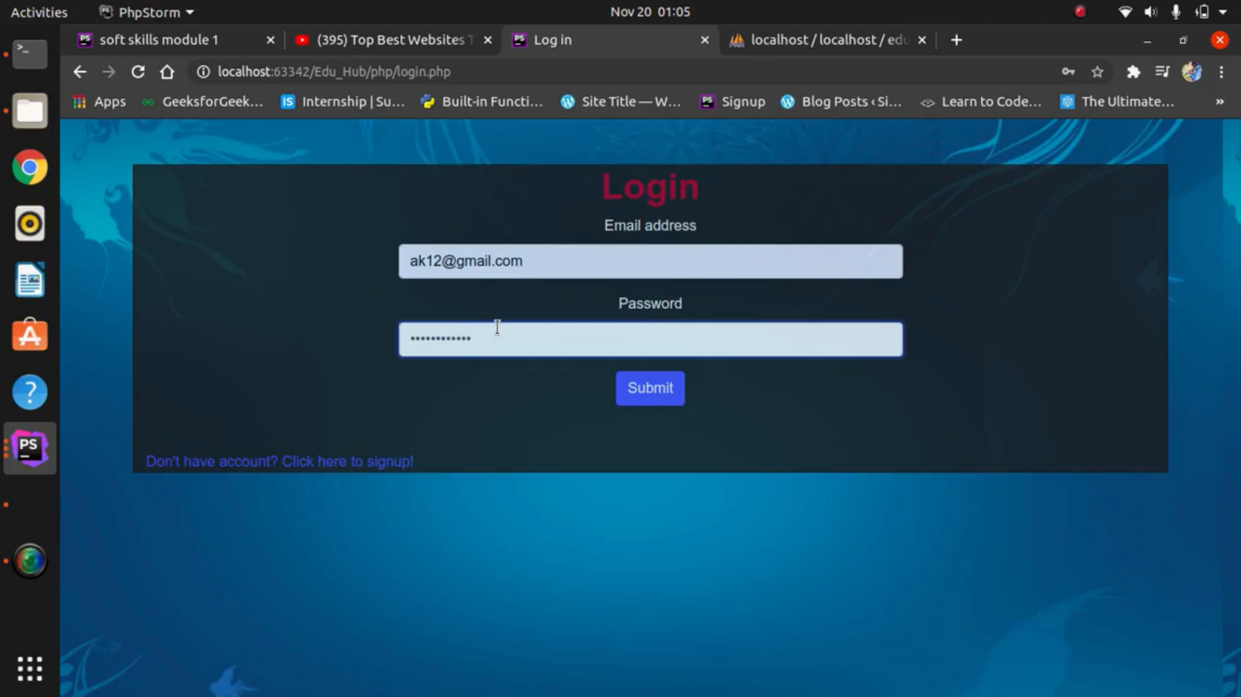

Slide 20
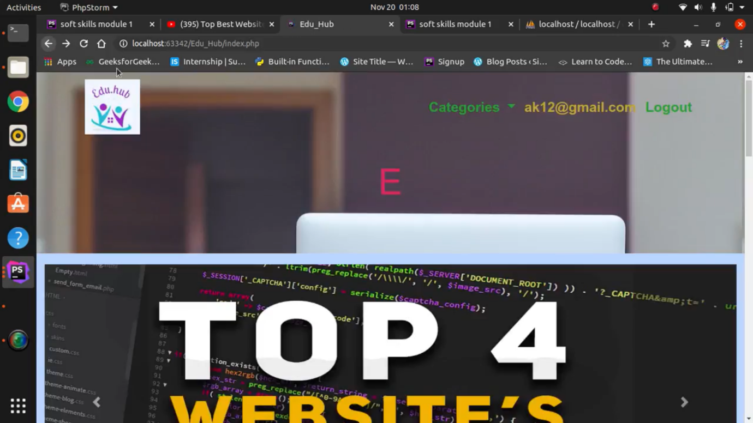

Slide 21
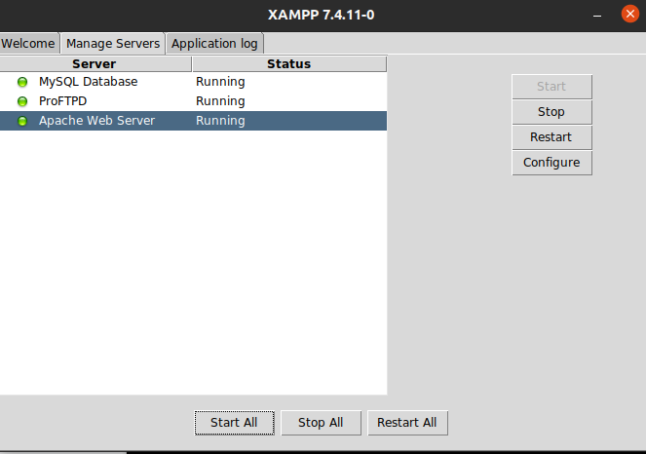
Server

Slide 22
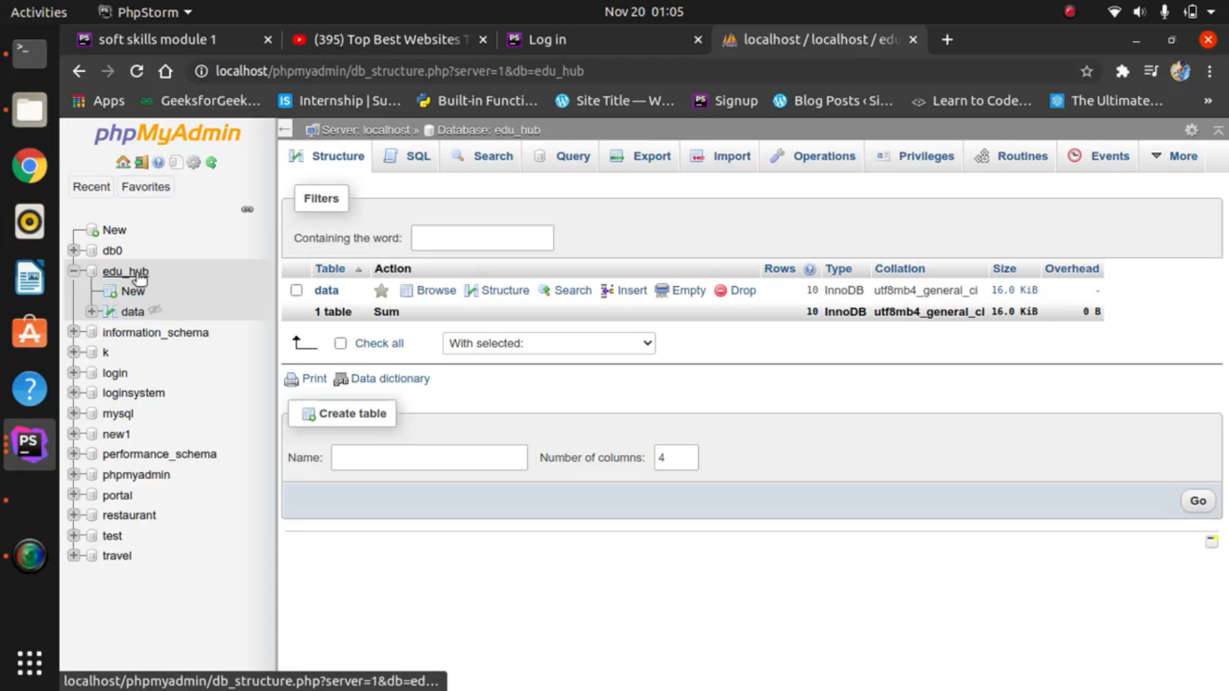
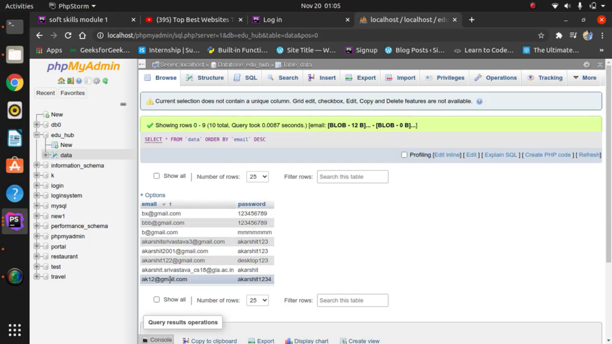

Slide 23
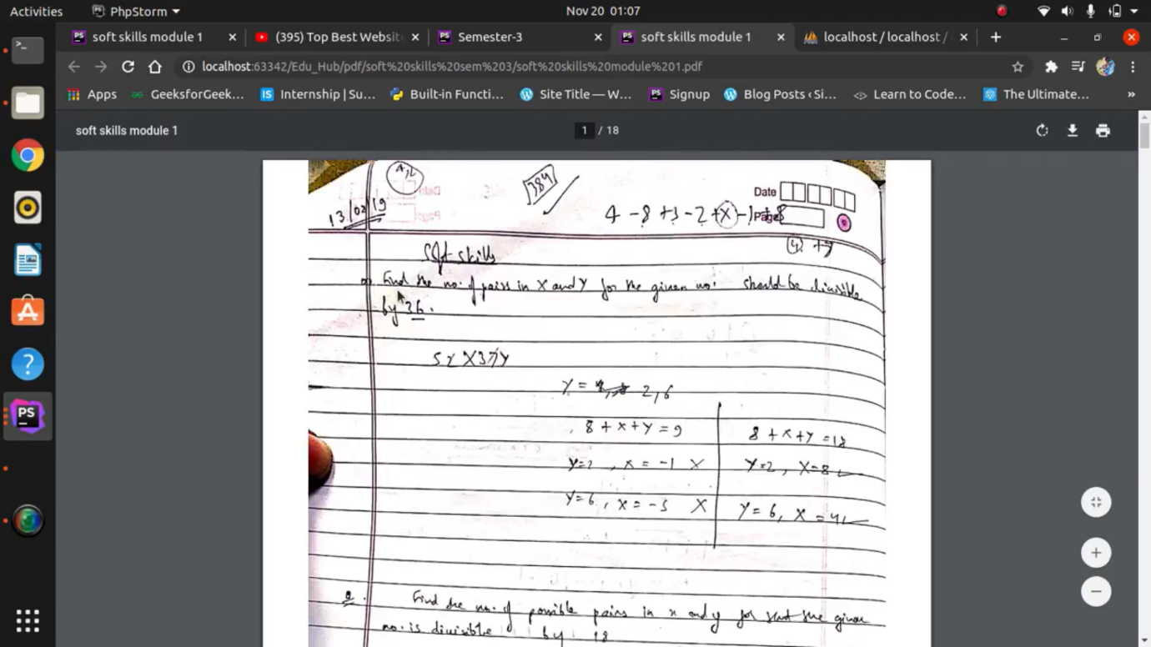
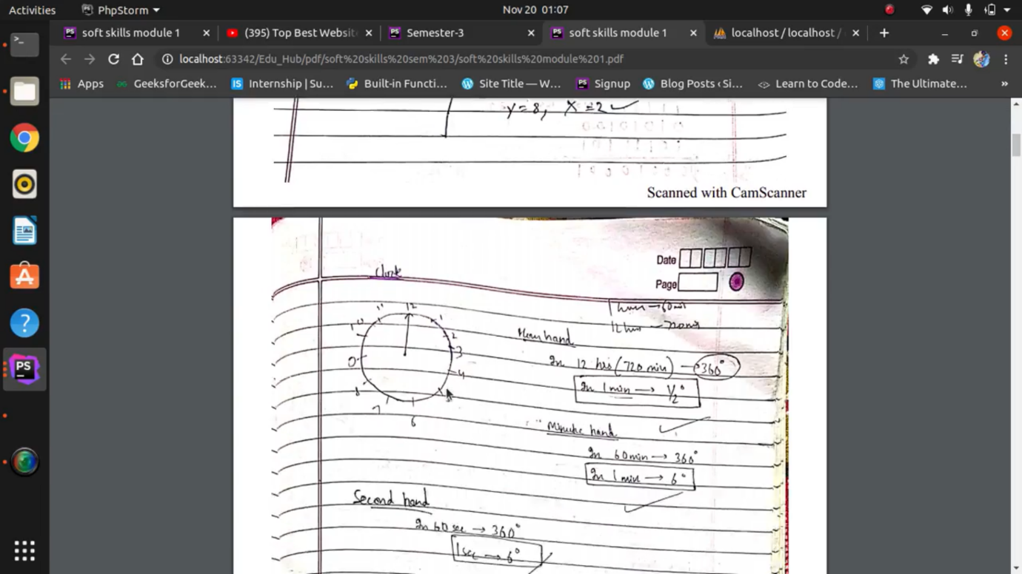
Some uploaded pdf’s

Slide 24
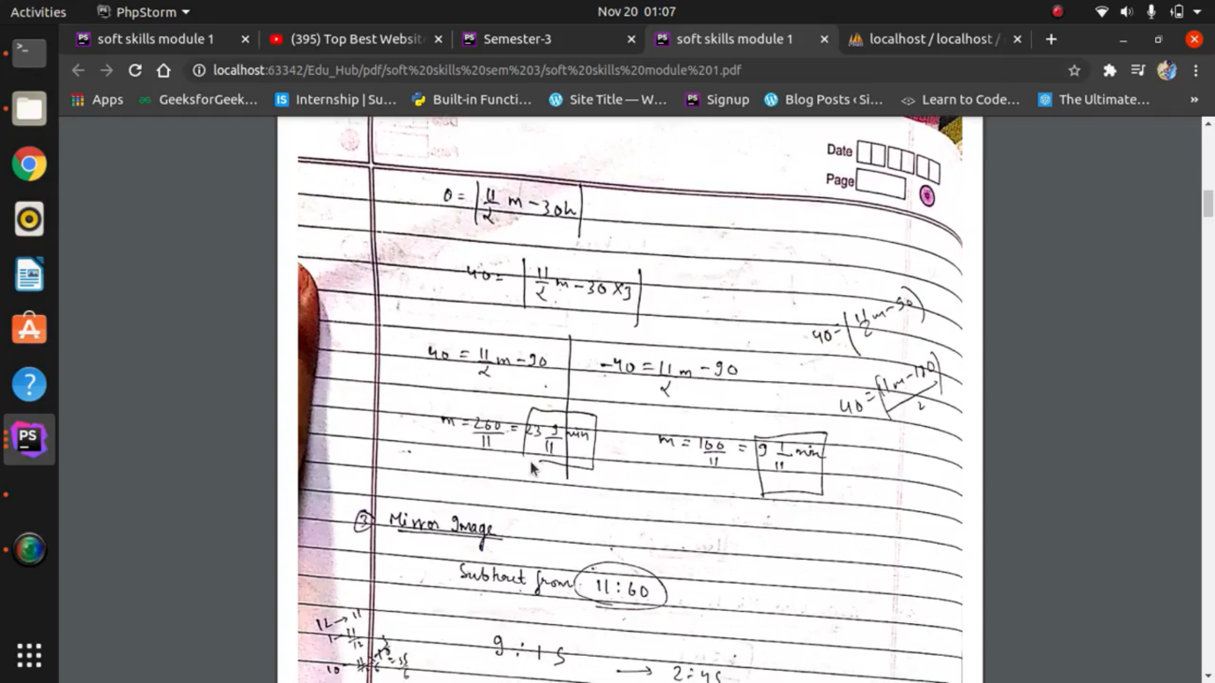

Slide 25
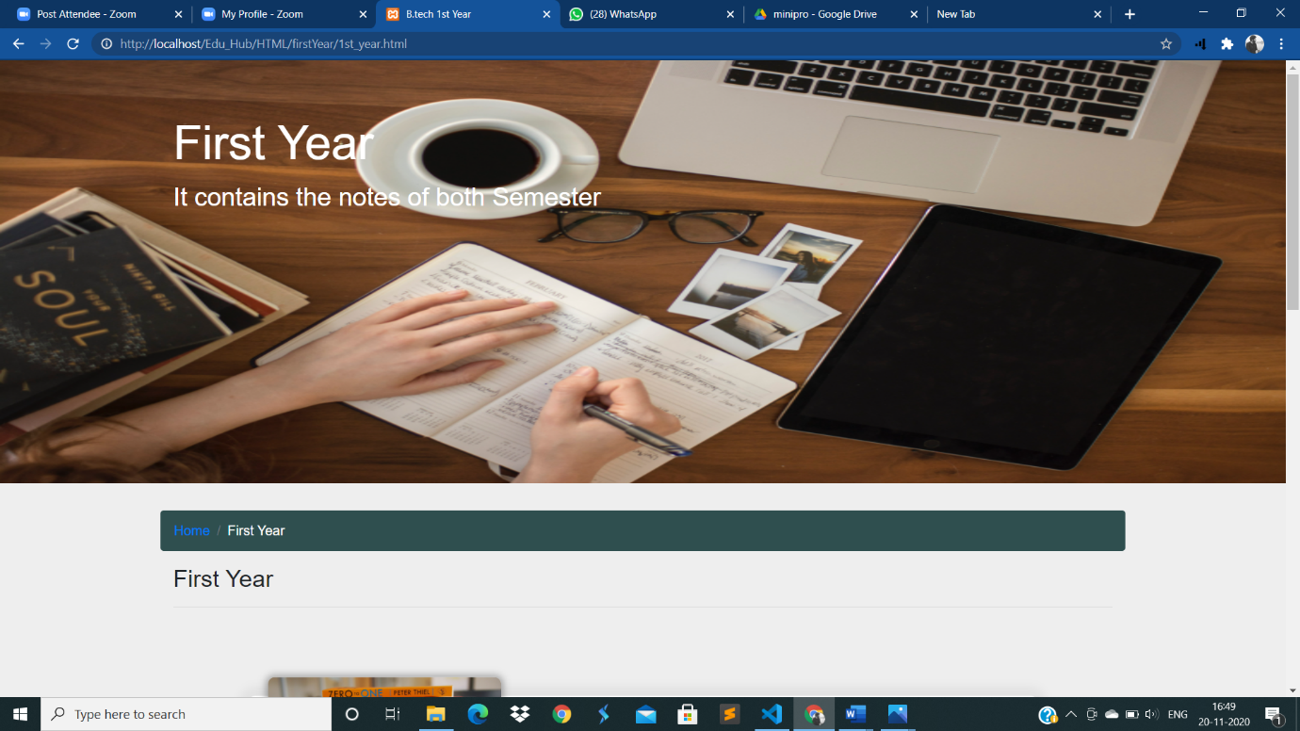
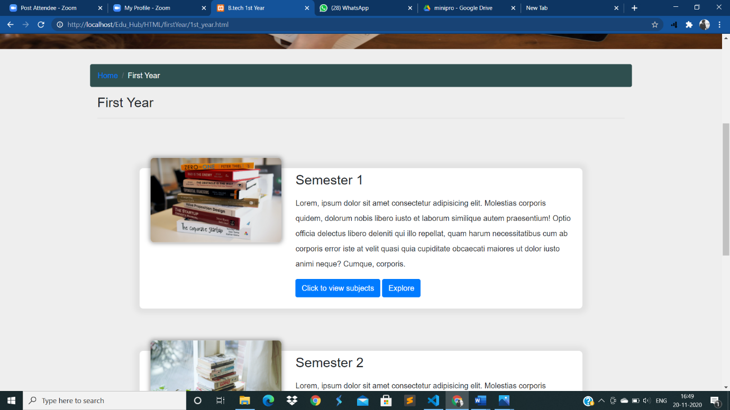
Rest of the pages

Slide 26
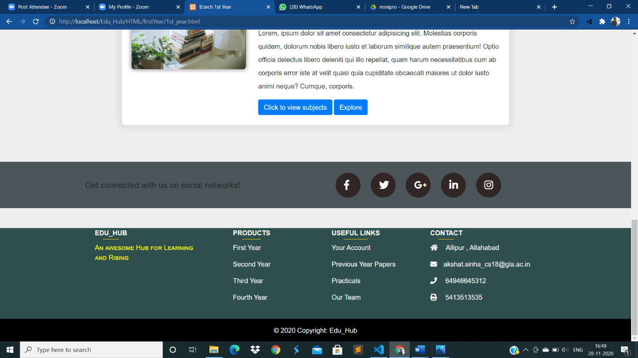
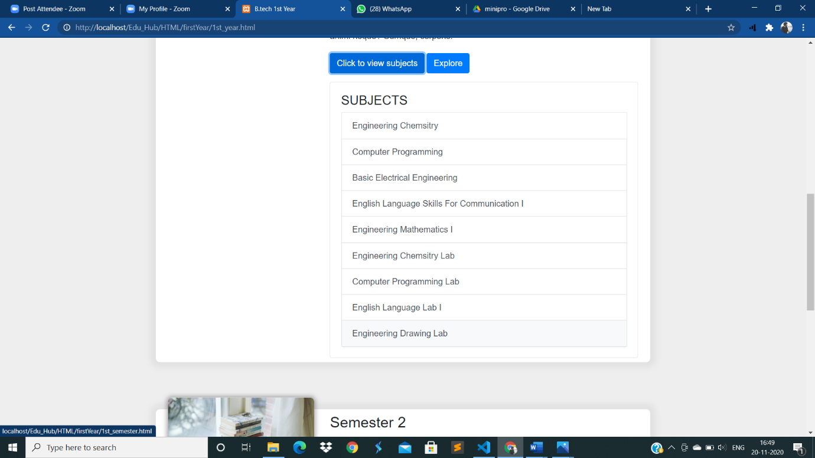

Slide 27
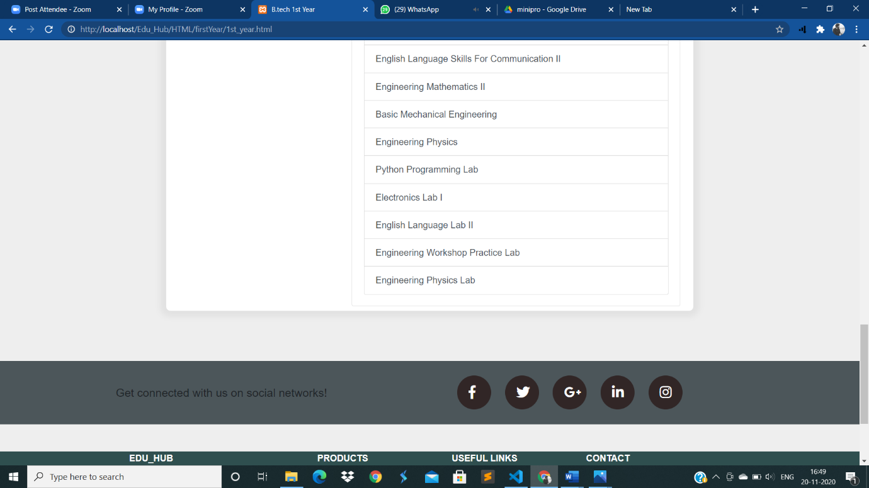
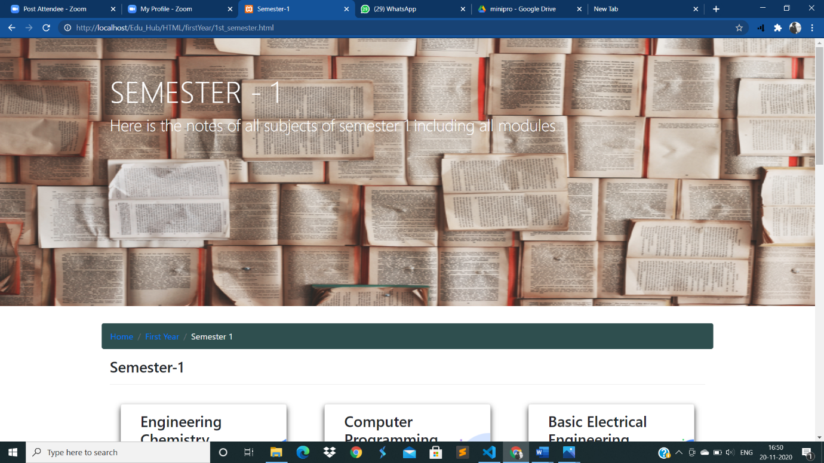

Slide 28
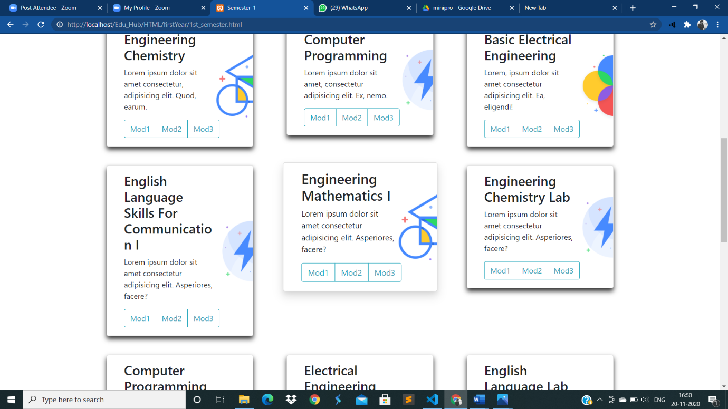
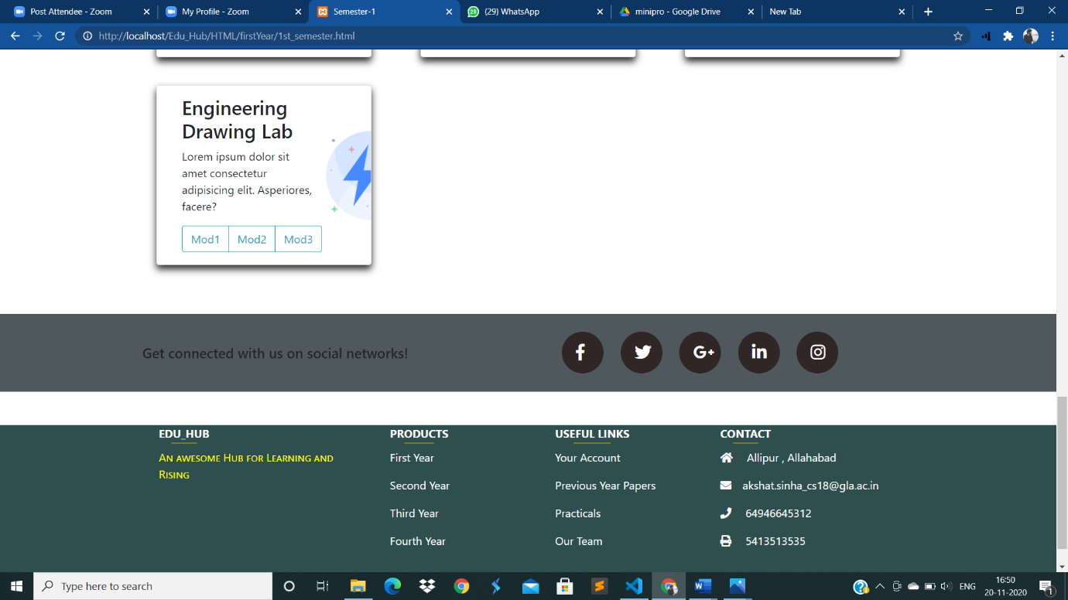

Slide 29

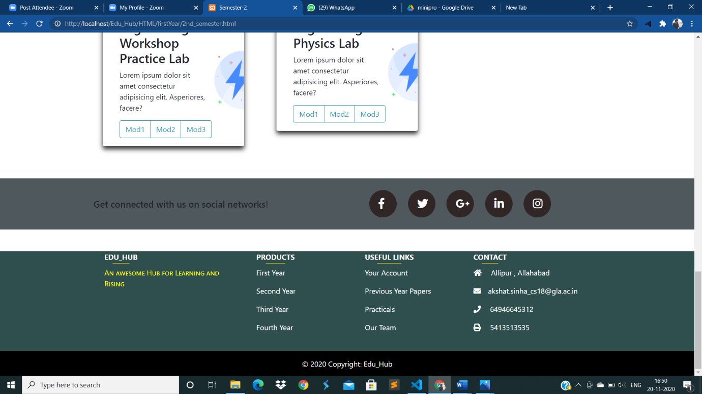

Slide 30
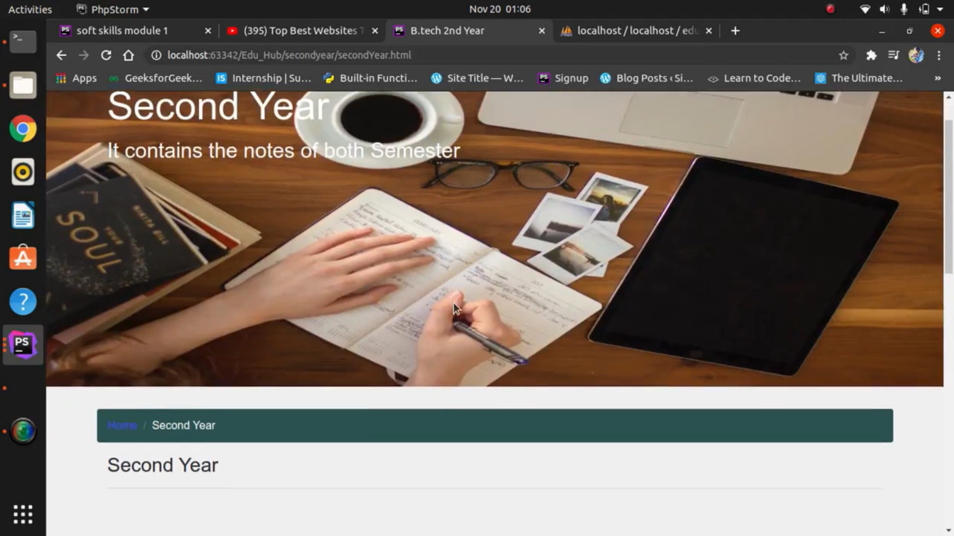
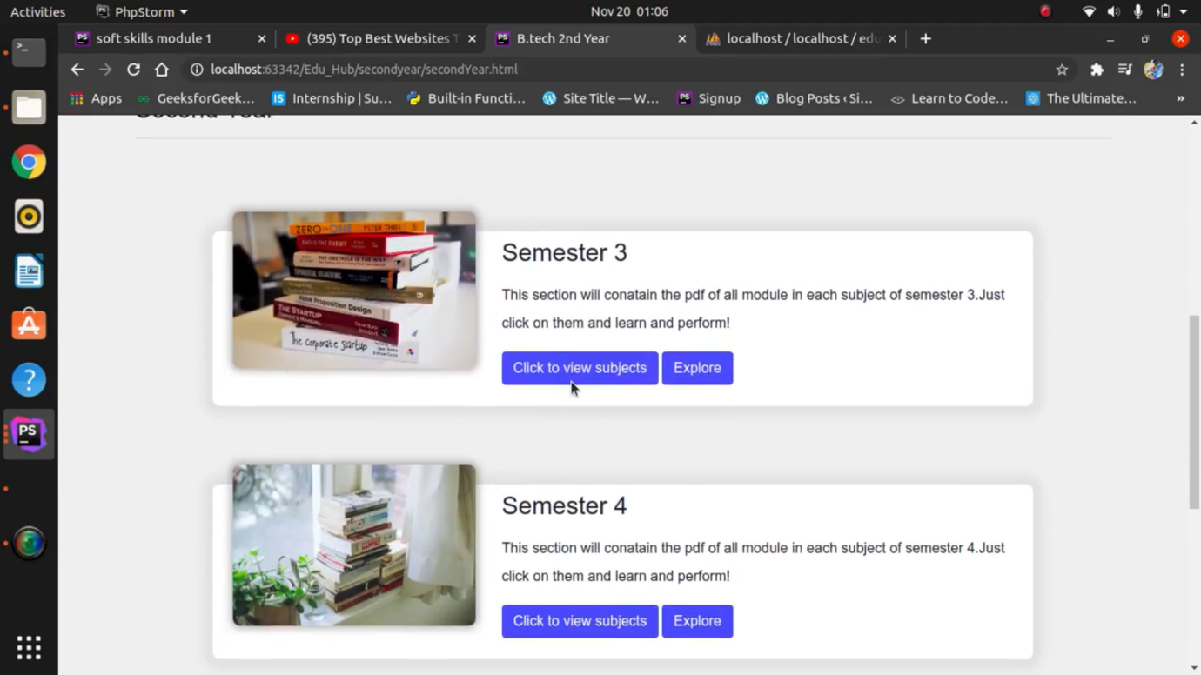

Slide 31
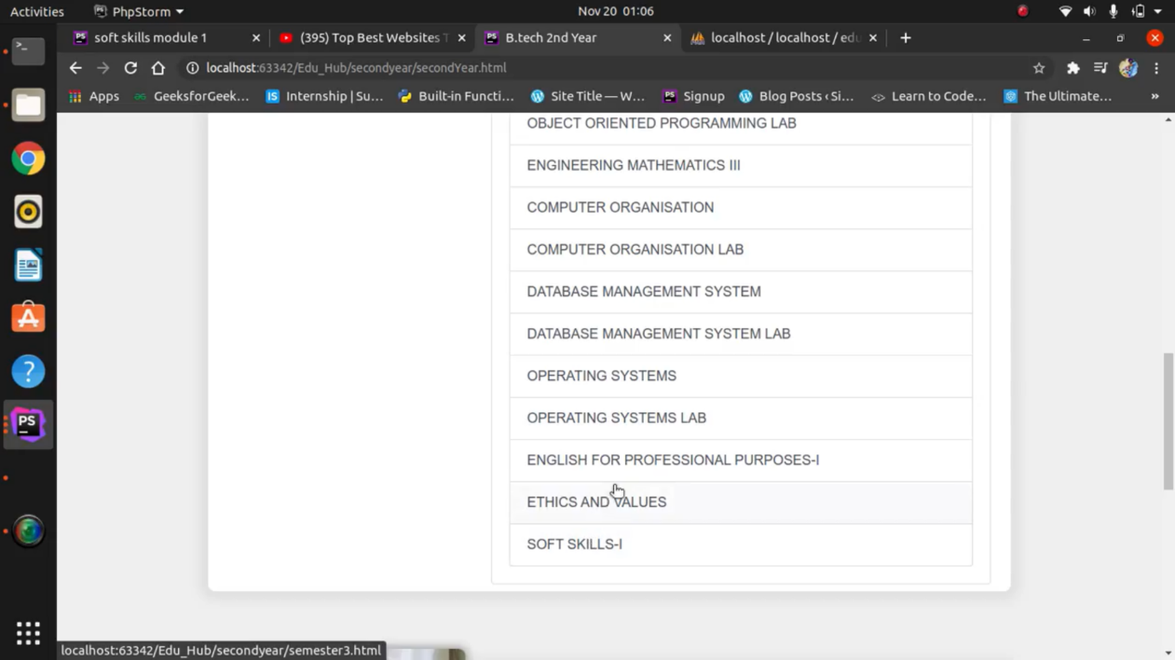
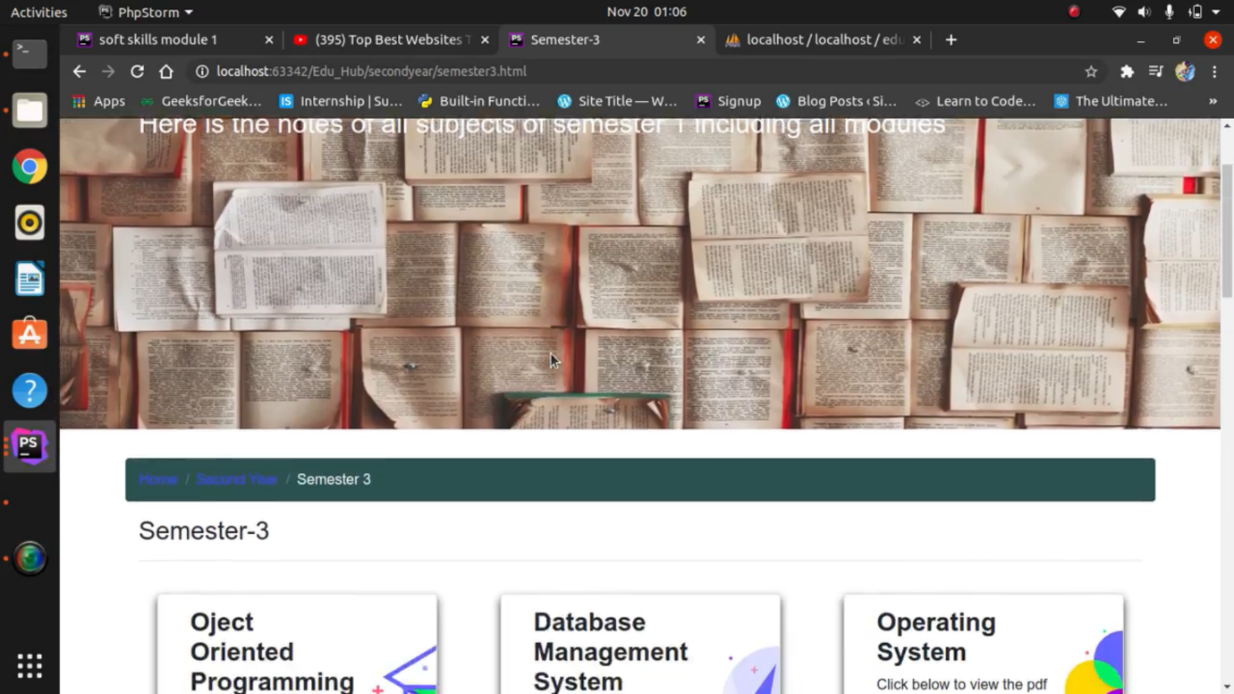

Slide 32
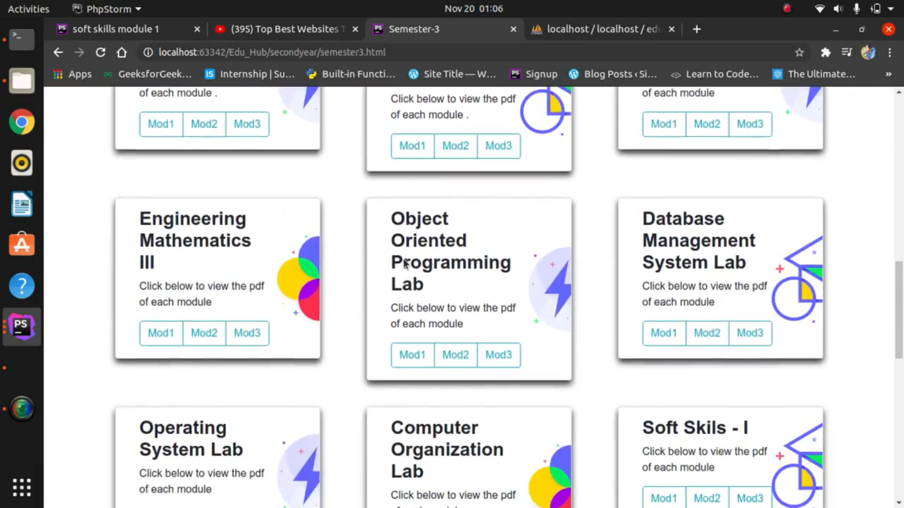
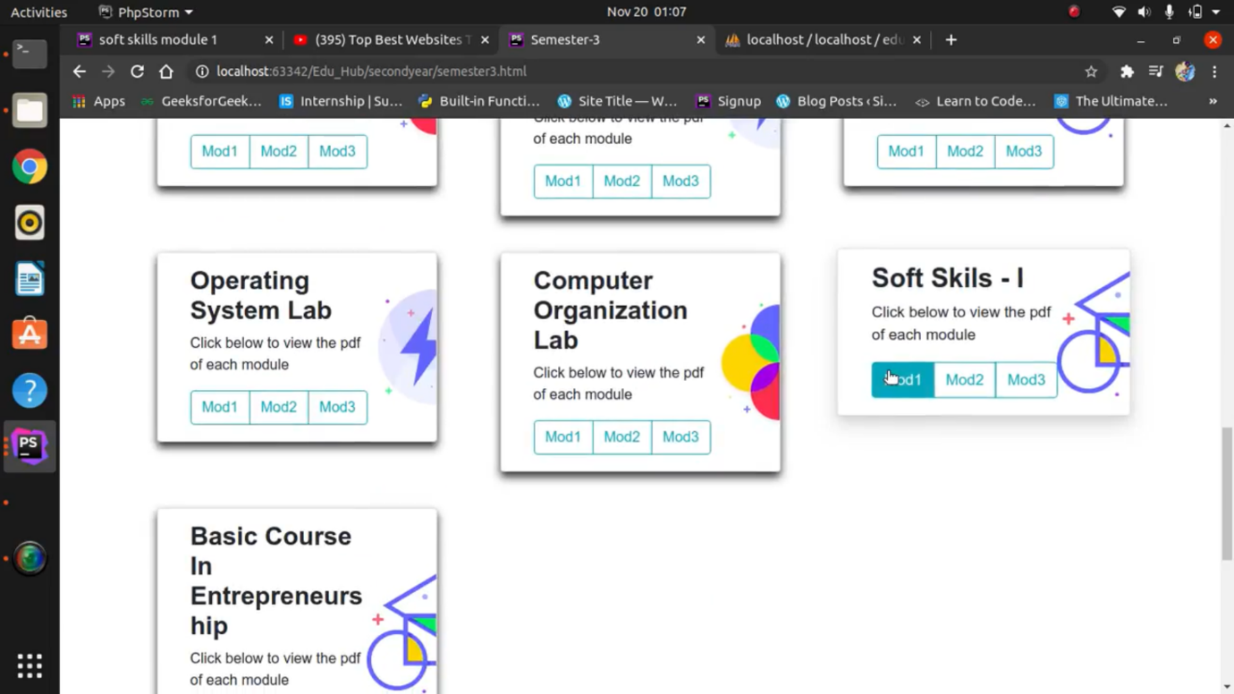

Slide 33



Slide 34
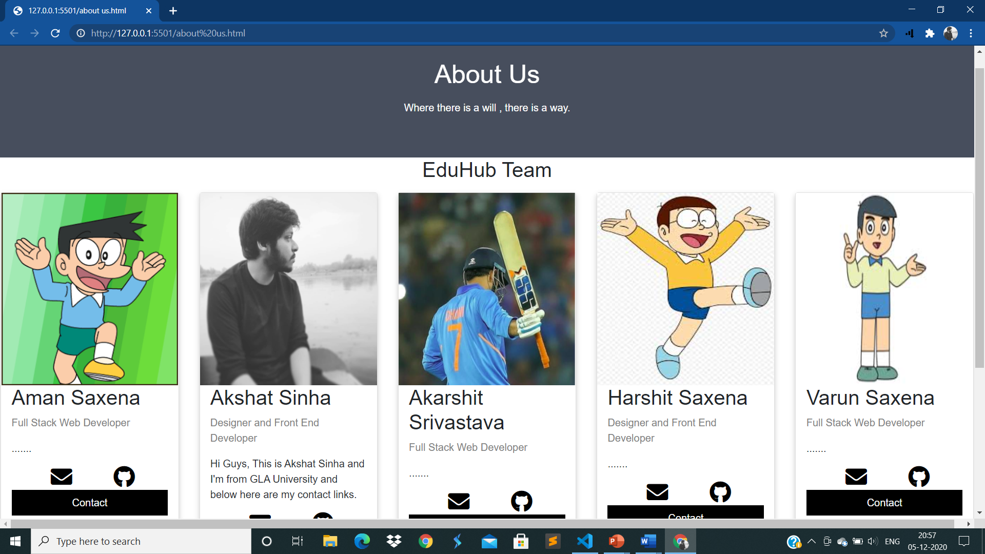

Slide 35
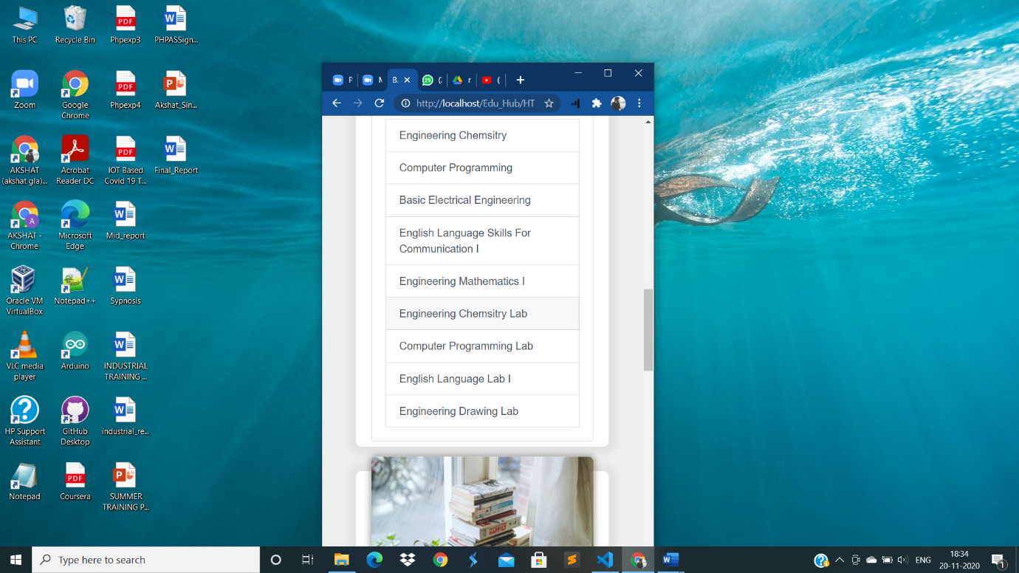
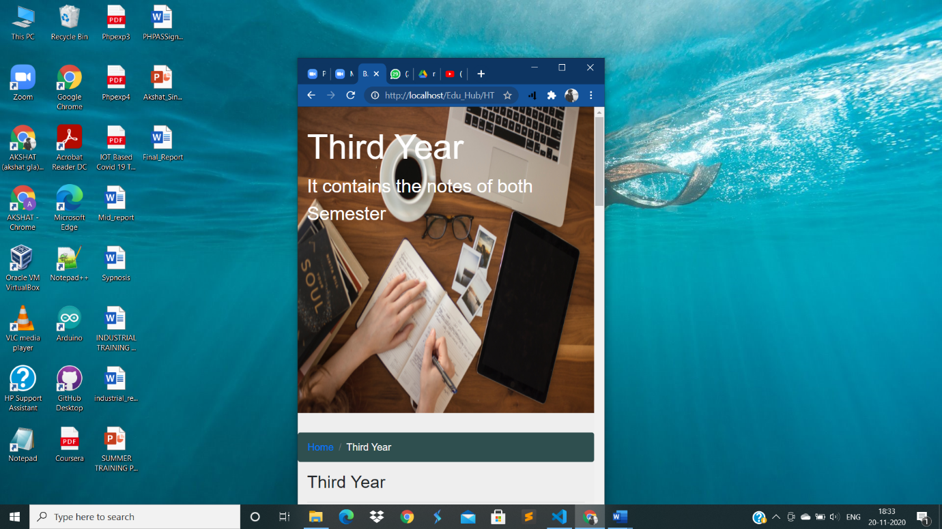
Responsive design

Slide 36
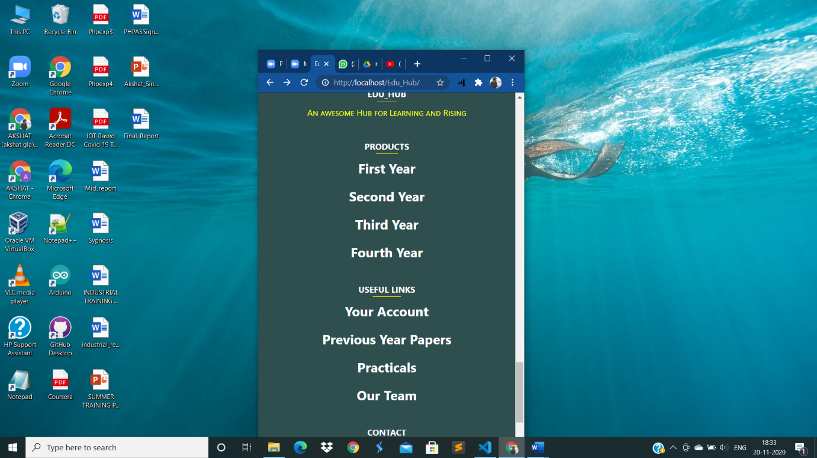
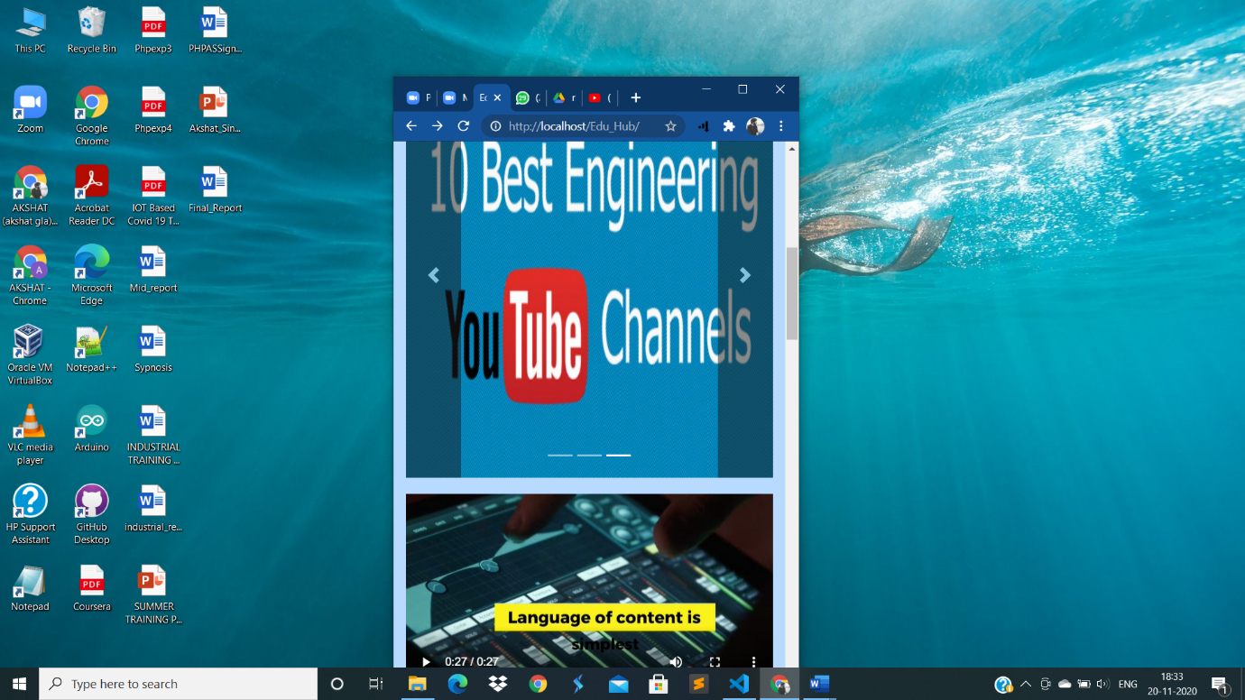

Slide 37
FUTURE SCOPE:
The future scope of this Project is to add links of video lectures for each and every topic of CS Domain as it will help the students in understanding the topics clearly and precisely.
Only authenticated users will be able to access our materials in the future. We will keep them updated with our new updates and notifications.
We will also add a blog section in our website where people having knowledge about challenging topics like AI, ML etc. can post their experiences and interact with the students for a healthy and fruitful discussions.
So, in a nutshell, the scope of this Project is to provide a complete package of resources to students who are interested in CSE domain and want to nurture their skills from a early stage.

Slide 38
Contribution the project would make
Our Project is centred on students from class 9 to CSE domain. It will provide various notes and resources to learn and take the pressure off of academics. It could be used as a helpful tool to utilize time, as in the current situation, students intend to clear their concepts by searching for their content on various search engines but end up getting their time and energy wasted. We would provide all the links and resources at one destination, so that students wouldn’t have to wastes their time looking for study materials all over the web.
Since our target audience are the students itself, so our website could be proved to be very helpful for the overall academic balance of the young minds.

Slide 39
CONCLUSION
Edu_hub will be a dynamic website that will provide a one-way destination to users to help them excel their academics. The YouTube links and various videos will help them to visualize the concepts and it will be easy for them to focus on their subjects rather than searching the web and wasting their time.
Our Project is a Full Stack domain project which uses both Frontend and Backend development.
We are optimistic that our Project would be able to solve some real-life problems.

Slide 40

THANK YOU

